Slide 1


Slide 2

Dear Parents,
To celebrate this school year and all the wonderful accomplishments the students have made, we will be having a social distanced scavenger hunt on the last day of school! I’ve included the basics of the hunt below. Please take a look at it. If your child will not be participating, no worries! Just please let me know by this Friday so we can plan accordingly!
The Basics:
Task 1: Students dress up in school spirit
Task 2: Students do an act of kindness for a classmate. Students will play ding dong ditch to enable social distancing. Examples: Create chalk art on sidewalk, write a letter, drop off an item like bubbles or a book that your child has read and thinks the classmate would enjoy. Partners will be assigned up so no one is left out.
Task 3: This clue leads the students to each pick up a cookie & sign.
Task 4: Students take a photo with the school in background holding their sign, taking a bite of their cookie, etc!
Final: Happy Summer/Farewell Note from teacher

Slide 3
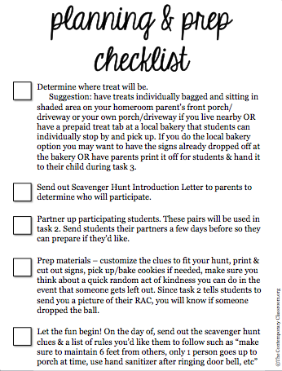

Slide 4

For our school and our class we’ve Got PRIDE.
Our love for them reaches wide!
Let’s show how much spirit we’ve got
By dressing up A LOT!
Whether dressing like our mascot or wearing our school colors just right
Let’s make sure our SPIRIT shines bright!
During this scavenger hunt, make it known
All the fun we’ve had this year as we’ve grown!
If you see a classmate be sure to yell from afar
“Wahoo!! Happy Last Day! You’re a superstar!”

Slide 5

Now that you look the part,
You are all ready to start.
You’ve learned how to be a friend and no matter if near or far
The friends you’ve made this year are on par!
Show a classmate how much you care
By leaving them a note, activity, chalk art, or a bear.
Be sure to put some thought
Into telling them why you like them a lot
Think of what makes them special and cool
Perhaps something you know about them from school.
Have you heard of ding dong ditch?
Now’s the time and I hope there won’t be a glitch!
This morning, leave your gift on your classmates porch or driveway,
Ring their doorbell and then run away
We’ve missed each other deeply and now’s the time to share.
Our class would not be the same without your flair!
E-mail your teacher a picture of what you’ve done
That way she knows the fun has begun!

Slide 6

The things you’ve done this year have been neat!
I believe it’s time you deserve a real treat!
For your next stop,
I hope you will like the place a lot!
Head on over to _______________ for a special surprise
When you get there look around with your eyes
When you spy the gift
Be sure to be swift
But also remember to take your turn
and use the manners you consistently learn
Go up one at a time to grab a cookie and a sign
You may need to stand far apart in a line.
After you get it, head back to your car
These are the yummiest cookies by far
But wait! Do not eat your cookie just yet!
There is one last task that you must not forget!

Slide 7

You’ve worked hard and had fun this year.
Now, it is time for us to make a cheers!
Head over to the place where it all started.
The place many of us wish we never had parted.
Pull into the drive
and think of something from this year that made you thrive.
With the school in the background
Grab the treat and sign that you found.
Smile big and take a photo
to celebrate all the ways you did grow!
Share your photo with your teacher and classmates
Because we all think that you are great!

Slide 8

While the hunt has come to an end,
Know the following is not pretend...
I was truly the luckiest teacher to get to have you in my class
I hope that you had an absolute blast!
You made my day with your fun stories and bright smile
I know you will go far due to your hardworking style
If you ever get in a bind
I hope you remember you are so smart, friendly and kind
In the future, be sure to stop by
Even if it is just to say “hi”
You and your family will be in my heart forever
I wish you luck with anything you choose to endeavor!
I hope your summer is great
Filled with fun, adventures, and time to create ☺
Love,
Your Teacher

Slide 9


Slide 10
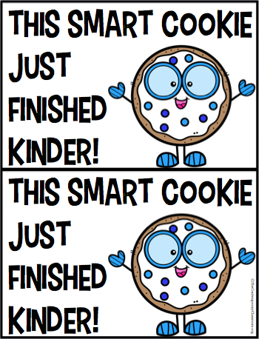

Slide 11


Slide 12


Slide 13


Slide 14


Slide 15


Slide 16


Slide 17


Slide 18


